Slide 1
Scientific Computational Reproducibility
Computational Reproducibility: If same application is run on different machines(combination of compatible hardware/software) the computational result should be reproducible.
Application
Application
Execution Environment
Execution Environment
Outcome-A
Outcome-B
Hardware A
Hardware A
Outcome-A === Outcome-B
Machine-A
Machine-B
By: Amarjeet Sharma

Slide 2
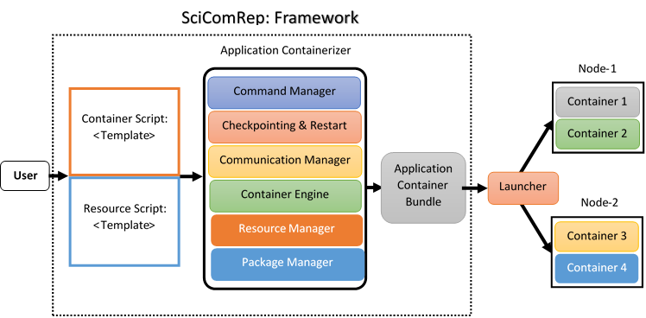
Proposed Framework

Slide 3
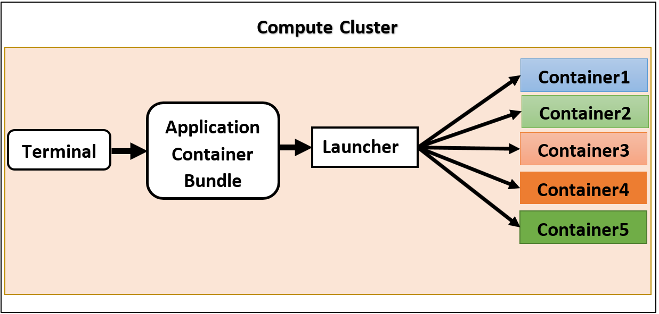
Summary
SciComRep would ease to develop reproducible applications.
It will speed-up development and debugging process.
It will help in increasing usability/reproducibility of researchers work.
Introduce platform independencies (provided compatible libraries and execution environments) for Applications.
The framework can also be used for power optimization in heterogeneous cluster using node consolidation.

