Slide 1
EDUHIPC-18: WORKSHOP ON EDUCATION FOR HIGH-PERFORMANCE COMPUTING, 17 December 2018, Bengaluru, India
Parallel & Distributed Computing (PDC) Using Low Cost, Compact and Portable Raspberry Pi Mini Cluster: Pradyut
Deepak Aggarwal¹, Prashant Kumar¹, Harish Charan² and Hemant Joshi¹
¹Institute for Plasma Research, Gandhinagar - 382428, Gujarat, India
²Weizmann Institute of Science, Herzl St 234, Rehovot, Israel
E-mail : deepakagg@ipr.res.in
Paper # 10
17th Dec 2018

Slide 2
Work Objective and Set-Up of Cluster
Work Objective
It is highly desired for the academia to utilize the power of parallel computing, specifically using the cluster-based HPC facilities.
There is lack of infrastructure, experience and high cost of setting up an HPC facility.
Here we explore an alternative approach to the big HPC facilities, which is affordable, easy to set-up, compact, portable and require no maintenance. With 4 cores and 1 GB RAM Raspberry Pi is a good candidate cluster.
4-node cluster named Pradyut will help students in hands-on experimenting with the cluster design, set up and the administration.
Master Node and Compute Nodes Setup
Schematic of the node set-up of 4-node cluster
Nodes are booted up and connected to the network switch.
The default hostnames changed to pi-master and pi01, pi02, pi03 respectively to avoid conflicts in network.
For communication, one public IP (for outside world) and one private IP assigned to master node whereas compute nodes have only private unique IPs (for internal communication).
For providing password less communication, SSH keys for each node were generated and copied on each other.
NFS Setup & Software Environment for PDC
Schematic of the 4-node cluster
Pi-master has been configured as NFS server and pi01, pi02 and pi03 as NFS clients.
A 16 GB pen drive connected to pi-master mounted on the it and is used as a shared directory across the nodes.
To understand the concepts of PDC, two standard parallel programming modes used in HPC viz. MPI and OpenMP need to be understood.

Slide 3
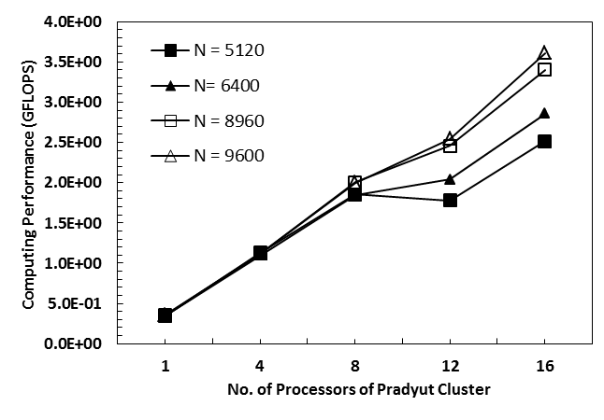
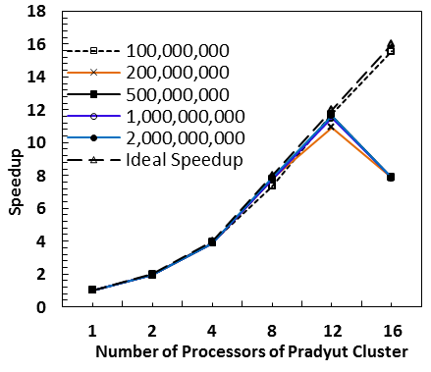
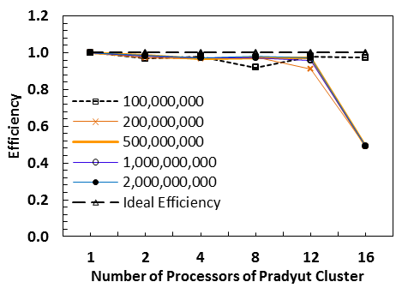
Cluster Details and Performance Results
The hardware components required to assemble cluster are given in below table.
I. HPL Benchmark
II. Speedup and Efficiency of Cluster for Computing π
HPL-2.1 was installed to test the cluster performance.
Modified HPL.dat file cluster starting with 1 core on a single node to total 16 cores of the cluster.
Here we have analyzed the speedup and efficiency of a program (in serial and MPI modes) that computes π using integration approach.

